Slide 1
Smart Knowledge Agent
The next generation machine comprehension engine
AwA Demonstration
4 Sep 2019

Slide 2

Smart Knowledge Assistant AwA Agenda
Topic | Leading | Approximate Timing
Introduction & background | Catherine | 5 mins
Digital assistant emerging trends | Catherine | 5 mins
History of Natural Language Processing and its implementation | Catherine | 10 mins
Operational Blueprint current challenges | Jeremy | 5 mins
Proof of concept (scope, demo & feedback) | Jeremy & Timothy | 10 mins
Solution Architect | Timothy | 20 mins
Demo | Timothy | 5 mins
© 2019 KPMG, an Australian partnership and a member firm of the KPMG network of independent member firms affiliated with KPMG International Cooperative (“KPMG International”), a Swiss entity. All rights reserved. The KPMG name and logo are registered trademarks or trademarks of KPMG International. Liability limited by a scheme approved under Professional Standards Legislation.

Slide 3

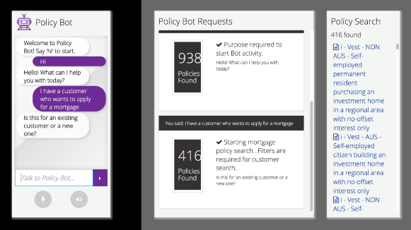
Introduction & Background
March 2019
May 2019
The Clients attend the Emerging Technology Insight Session
Discussion was held regarding if this could be trialed using Operational Blueprint as a knowledge source
POC agreement signed
During this session KPMG showcased a financial services bot that had the ability to search through 1,000 policies
After some investigation KPMG provided an agreement to commence a limited Proof of Concept (POC)

Slide 4
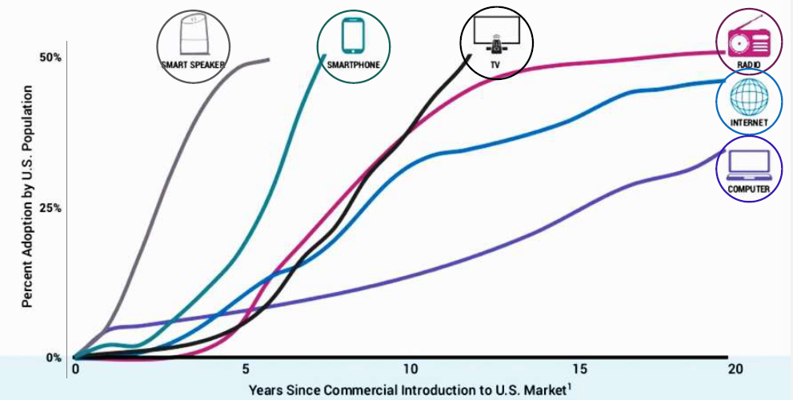
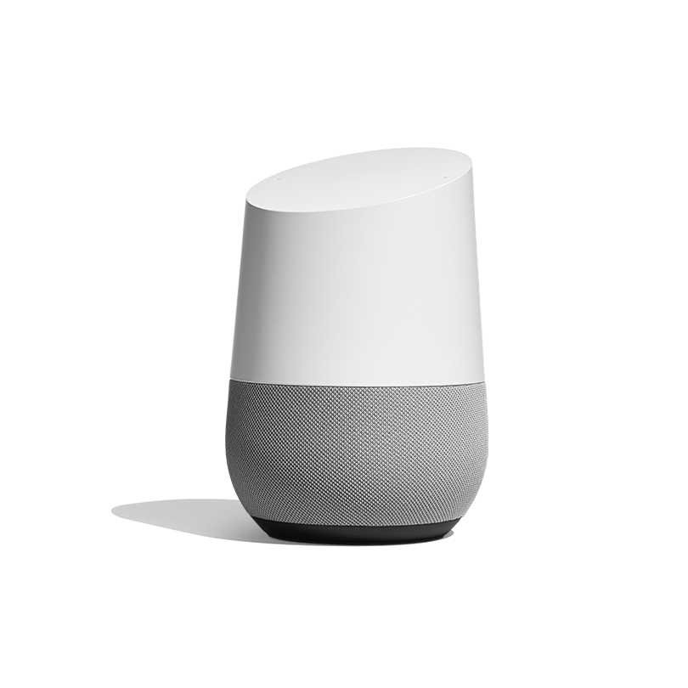
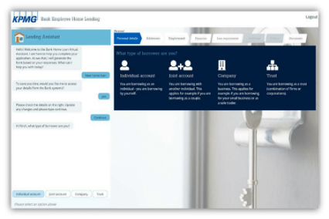
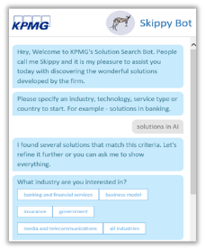
Digital assistant emerging trends
More smart
More Pervasive
Overall Developments
Increased fusion with RPA and cognitive automation
Faster time for training, development and deployment
Lower cost development - the professionalisation of annotation
Bots are no longer new, more users, more adoption
2019 was a big year in Natural Language Processing technology with new breakthroughs in transfer learning
Voice activated devices are fastest growing consumer technology ever, faster than smart phones reaching 11.7 million in 2018
Integration with voice channels (contact centre)
Integrating more customer data for context and personalisation
KPMG Examples
Voice enabled welfare application bot (USA)
Application Processing Bot
KPMG Skippy Bot

Slide 5
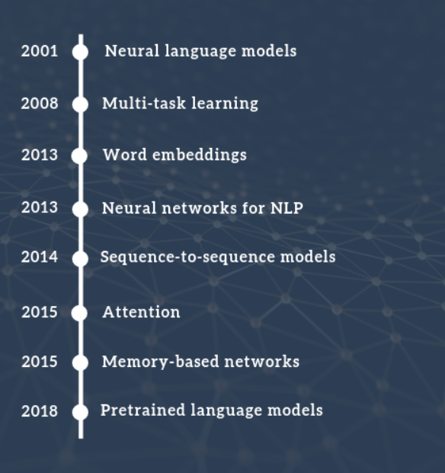
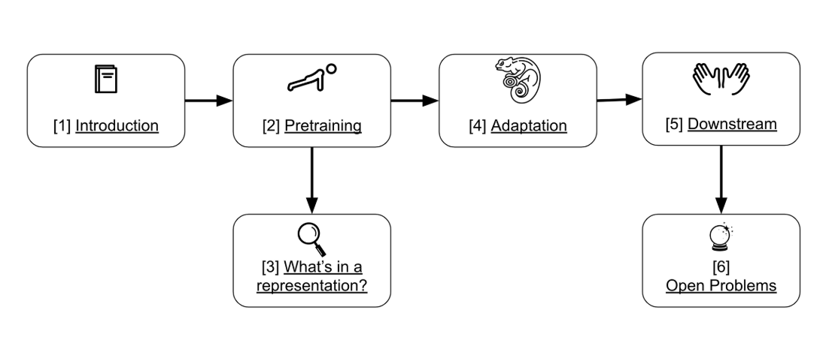
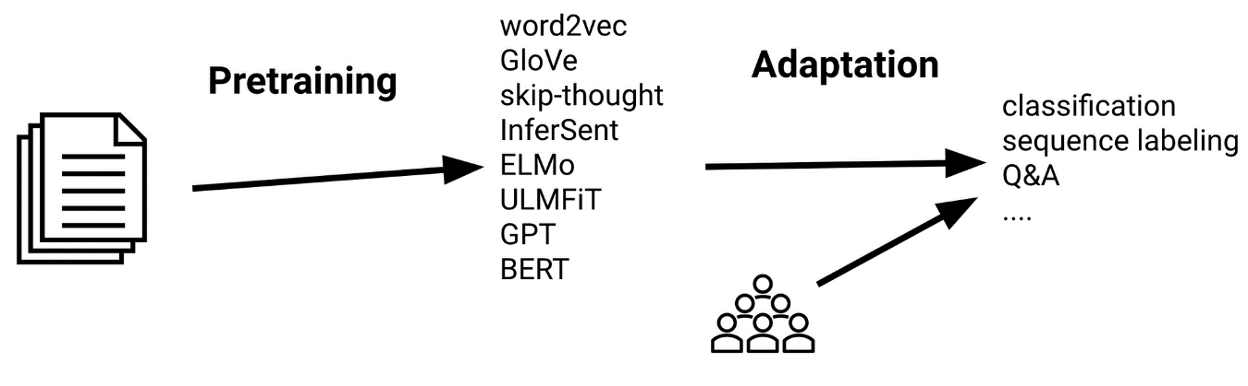
History of Natural Language Processing and Transfer Learning

Slide 6
Operational Blueprint current challenges
ACCURACY
SPEED
INNOVATION
“the keywords a user types in the search box rarely brings up the target process page”
“the OB system returns massive content which makes it hard to get to the right place in the right program”
“OB cannot save or customise search results for individual users or user groups based on the search history”
“current OB search cannot return accurate results”
“OB system returns a long list of results requiring extensive manual reading to locate the right answer”
“the system does not store user search history for different user groups”
“current search makes it hard for the user to go to the exact page of the policy they want”
CONFIDENCE
“No feedback function in the existing system to correct the search result, or rank the more relevant documents”
“the search function is basic and the returned results mainly depend on the terminology users use”
“OB does not understand high level and abstract key words (e.g. 5 years OTD or areas of consideration)”
“Need more direction when searching based on an abstract question i.e. follow up question”
“OB does not provide information about the access frequency of each policy document”
“the OB system doesn’t understand abbreviation or acronyms
“the content in OB is difficult to keep current and consistent because of the lack of a content management capability”

Slide 7

Proof of concept
Functionality
Chat Bot
AI assistant that can understand human interactions, text or voice and provide conversational dialog to help users achieve their goals.
Deep Learning Machine Comprehension
Cognitive Search
Cognitive search engine that can understand natural language and use metadata dynamically to search documents.
Cutting edge Natural Language Understanding model that leverages the power of deep neural networks, to enable machines to read and understand documents.
Smart
Knowledge
Assistant
Knowledge Management System
Continuous Learning
User feedback is recorded and used to update the deep learning model in real time. Response accuracy is improved with every click.
Knowledge management system that can help the organisation to manage their business information.
Advanced Analytics
Advanced analytics capability that can derive insights from the data to assist on decision making.

Slide 8
Proof of concept
Solution Architect
Input question
Return message
Back end
Chat history
Component 1
Archive
Front end
Authentication
Component 2
Chat window
Chat message handler
Chat framework
FAQ layer (InferSent)
Elasticsearch
Score > 0.9
Document layer (Elasticsearch)
Logo window
Logging
Tab layer (InferSent)
Tab finder
Raw DOC to HTML
Sub-tab layer (ensemble)
Machine Comprehension layer (BERT)

Slide 9
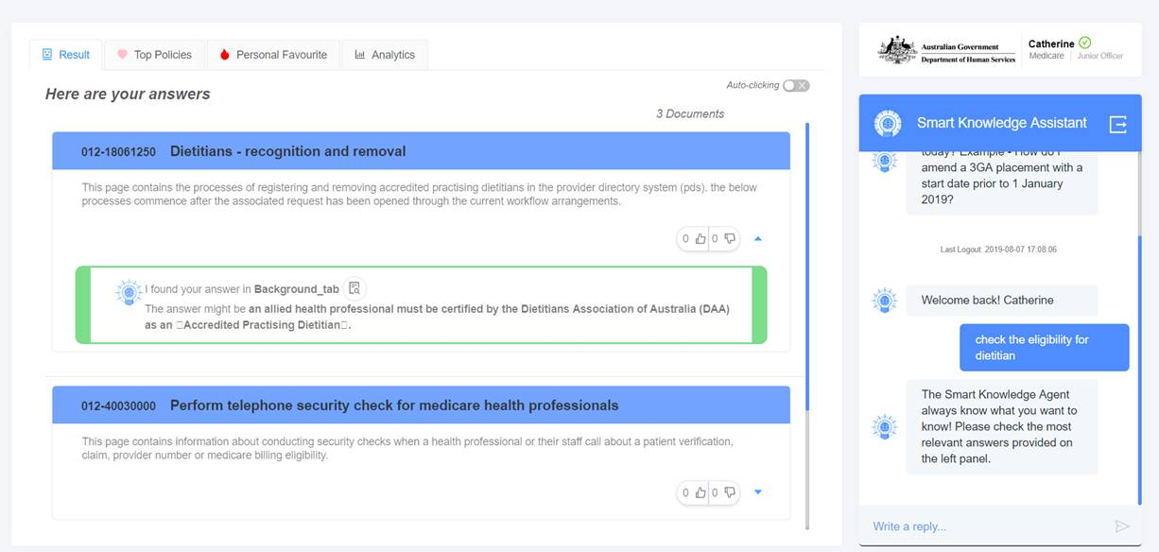
Proof of concept
Demo
Key features & challenges addressed
 | Cognitive search capability (speed and accuracy) |  | Top policies (speed and innovation)
 | 48 hours of conversation (speed) |  | Personal Favourite (confidence, speed and innovation)
 | Answer at a glance (speed) |  | Personalisation (confidence, speed and innovation)
 | Detailed drill down to policy (confidence) |  | Analytics (innovation)
1
5
2
6
3
7
4
8
5
6
8
7
2
7
4
3
1

Slide 10
Proof of concept
Demo
Key features & challenges addressed
 | Cognitive search capability (speed and accuracy) |  | Top policies (speed and innovation)
 | 48 hours of conversation (speed) |  | Personal Favourite (confidence, speed and innovation)
 | Answer at a glance (speed) |  | Personalisation (confidence, speed and innovation)
 | Detailed drill down to policy (confidence) |  | Analytics (innovation)
1
5
2
6
3
7
4
8
5
6
8
7
012-392834 Document Title 1
This page is about Customer service Collaboration research. Customer service is traditionally considered a cost center, so many organizations have focused their customer improvement efforts on reducing costs.
2
7
4
3
1
012-392834 Document Title 1
Business Insider experts predict that by 2020, 80% of enterprises will use Chatbots. According to Lauren Foye, by 2022, banks can automate up to 90% of their customer interaction using Chatbots

Slide 11
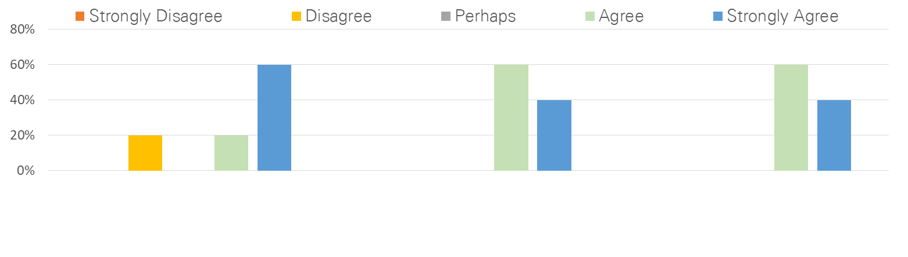
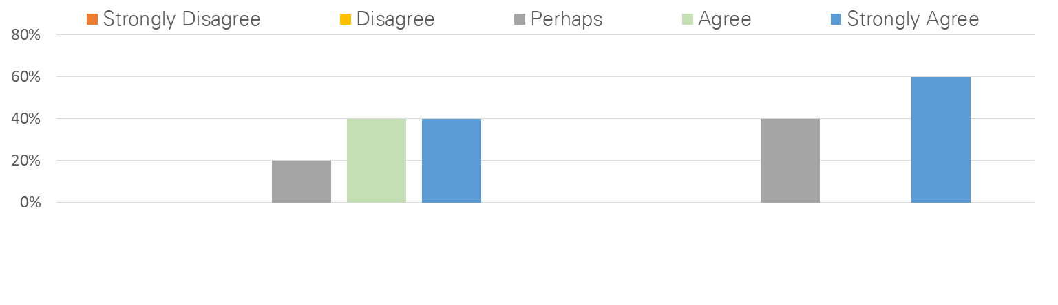
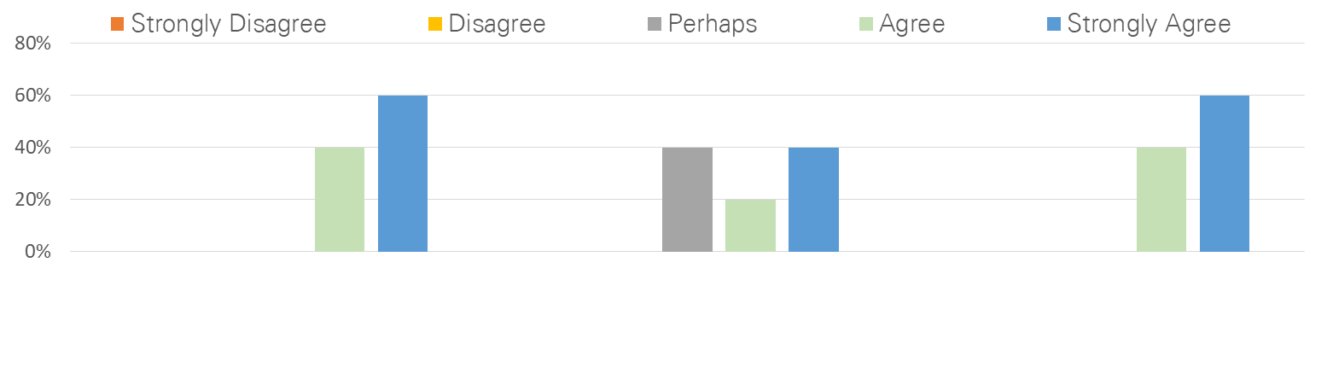
Proof of concept
Feedback
Accuracy & Speed
Adoption
I was able to find the relevant answer quicker compared to using the current OB search engine.
I felt the Smart Knowledge Agent is more accurate in helping me find the right answer to my question.
I would recommend my colleague(s)/team to use the Smart Knowledge Assistant, as it is now or with minor modifications, over the current operational blueprint search engine.
I feel that the Smart Knowledge Assistant could help the team to work more collaboratively and efficiently.
I would use the Smart Knowledge Assistant, as it is now or with minor
modifications, for searching for information from policy documents.
User Interface
I was able to interact with the Smart Knowledge Agent easily.
The highlighted answer in the policy documents helps me to find information within a policy document faster.
The brief snippet of the answer displayed in the search result gives me more confidence and more guidance to find the accurate policy document.

